Slide 1
Lecture 1 Introduction to Machine Learning Fall Semester 2020-2021 ⇨ Introduction
András Lőrincz
Department of Artificial Intelligence
Faculty of Informatics

Slide 2
Three courses in one lecture (this year)
BSc course for
Hungarian student of the Faculty of Informatics (2 credits)
English students of the Faculty of Informatics (3 credits)
MSc course for
Students of the Faculty of Education and Psychology (4 credits)
Basic knowledge of
probability theory,
linear algebra,
calculus
are required. Everybody is supposed to know these topics already. However, there are considerable differences that call for homeworks / excercises, mandatory for „Type 2” and „Type 3” students.

Slide 3
Homeworks / exercises
Lectures are on Wednesdays, between 4.00PM and 5.00PM
Due to Covid and to the large number of students who registered for the course, I am preparing videos for each lecture, since streaming may frequently fail and you could be lost in the lecture.
To each lecture there is a list of problems/questions. It is at the end of the talk. The starting slide of the list is titled: „what we learned today”. You have to submit your answers one day before the next talk.
I am not going to check if you are present at the talk or not. That, however, justifies the rigor concerning the homeworks and the questions and their precise, timely submission.
„Type 2” and „Type 3” students: You are supposed to do the homeworks and to submit them the day before the next lecture. Not all lectures have homeworks. But, if they do, then you need to submit the solutions one day before the next lecture.
Justification: Homeworks help your understanding of the coming lecture.
Consulting on the homeworks is possible.
Consulting teacher: Zoltán Milacski.
Consulting time: Tuesdays 7.00PM-8.00PM
Consulting is online. Questions are to be submitted on Mondays before 7.00PM.
Concerning the „questions”: all students are supposed to submit those before the next lecture.

Slide 4
Exam
Exams are the same for all three courses!
Note for all students:
We will try to exclude those from the exam who copied the answers of the homeworks/exercises
Examination starts with a written exam with
questions from the homeworks – in turn, „Type 1” students may wish to do the homeworks, too...
questions from the lists on „what we learned today”
It is our goal to discourage communication – a hard task for us, since the exam is online. This is our plan:
You may need to perform short computations with a single number to be submitted
You will have quizzes to be filled in
Short computations (if any) and quizzes will be randomly selected for all students and will be sent to you individually at the same time.
Response time will be limited
It will be hard to finish the quizzes in time – an additional constraint that I have to exploit – and we will use statistical means to grade you.
See an additional constraint below concerning the homeworks and questions to be unswered during the year.
I am sorry about the uncertainties here (i.e., that definite levels can not be given to you). I am open to any suggestion that takes of the burden of 300 individual examinees
Grading:
Have you submitted your homeworks and answers to the questions in time? It is important to submit your answers as detailed before. Nonetheless, you may miss uploading 3 responses and you can still enter the written exam. Grading levels for the written exam will be given at the time of the exam – but see points 1&2 above.
Academic dishonesty (quoted from Dana Ballard’s course): Students caught plagiarizing will fail the course. On some projects, we will use software to analyze code similarity. Avoid plagiarism when coding and when answering the questions by carefully citing all your sources. If you use a specific short code snippet found on a web-page, mention that fact in a comment. If someone else told you how to solve a tricky part of an assignment, give them credit, too. Do not copy code from other students. However, if you did and cited them for it, I suppose that you would not fail for plagiarism; you simply would not get credit for the assignment. Even so, don't do it.

Slide 5
CONTENT
Old New
1. Introduction
2. IQ and making sense
3. Key problems of AI and HI
4. Goal oriented systems
5. Classical AI, learning from examples, combination
6. Image processing
7. Speech processing
8. Video and natural language processing
9. Embedding and visualizations for human understanding
10. Human-machine interaction
11. Distributed intelligence
12. Summary: Artificial General Intelligence
1. Introduction
2. Cognition, IQ and making sense
3. Key problems of AI and human intelligence
4. Goal oriented systems
5. Classical AI versus learning from examples: how to combine them?
6. Image and video processing
Mid-term exam (October 21, 2020)
7. Speech processing, natural language processing
8. Behavior characterization and situation understanding
9. Explainability (XAI) for human understanding, information fusion and distributed intelligence
10. Human-machine interaction, „Edge TPUs”, and distributed intelligence
11. Control, influencing, fake information, legal and ethical issues,
12. Summary: Artificial General Intelligence
➔ Final exam

Slide 6
We turn to the Introduction

Slide 7
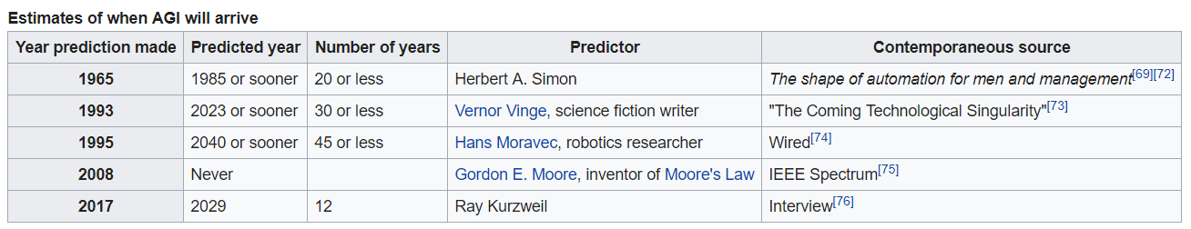
Predictions
”10 years from now, AI will overcome NI (natural intelligence)”
from Wikpedia
AI pioneer and economist Herbert A. Simon inaccurately predicted in 1965:
"Machines will be capable, within twenty years, of doing any work a man can do".
In 1970 Marvin Minsky wrote that
"Within a generation... the problem of creating artificial intelligence will substantially be solved."^{[69]}
Bill Gates in 1998
Dialogue systems will be working in 10 years
But today, we are experiencing a breakthrough and superhuman performances in diverse fields → We still can’t predict what is to happen.

Slide 8
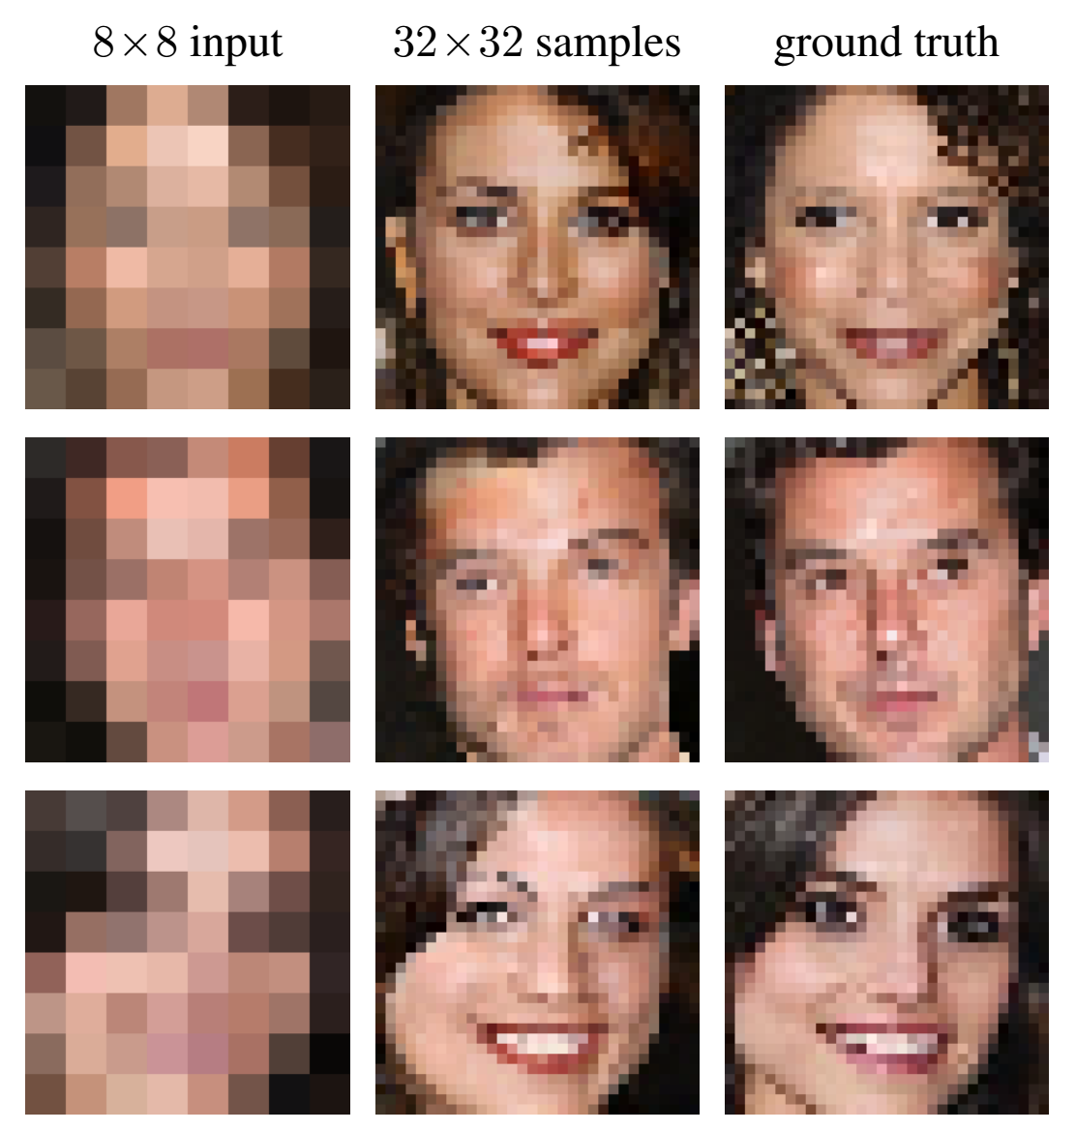

What are these?
What is the DNN to say?
Are these the ones?
AI is „Superhuman”
Deep network
abilities
Superhuman performance
in sensing – see the example above
– and
in table games (not shown)

Slide 9
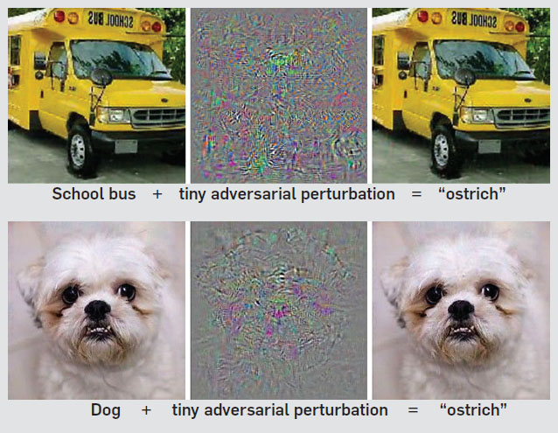
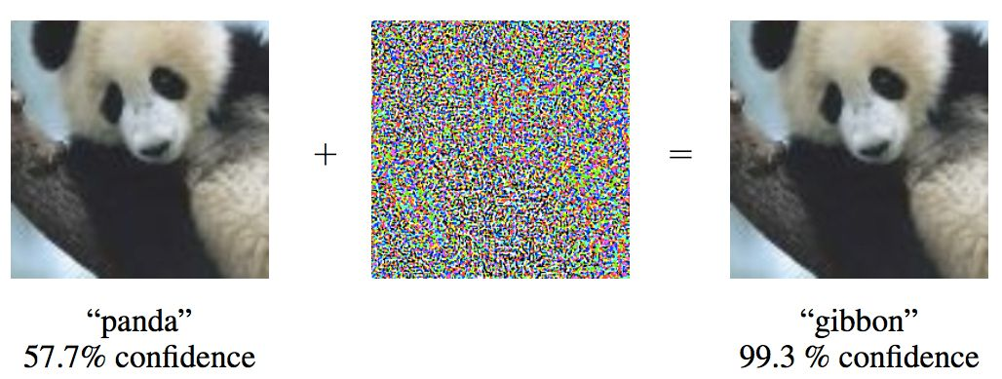
AI IS „SuBhuman”

Slide 10
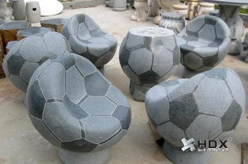
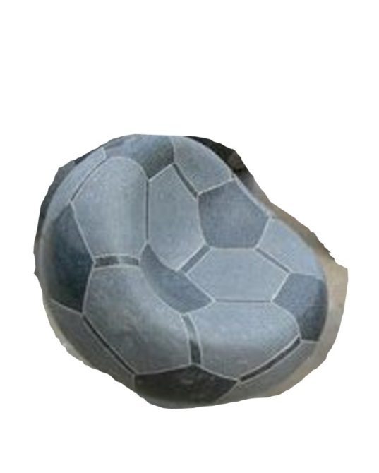
One of OUR ERRORS „human”
What is this?
Are you sure?

Slide 11
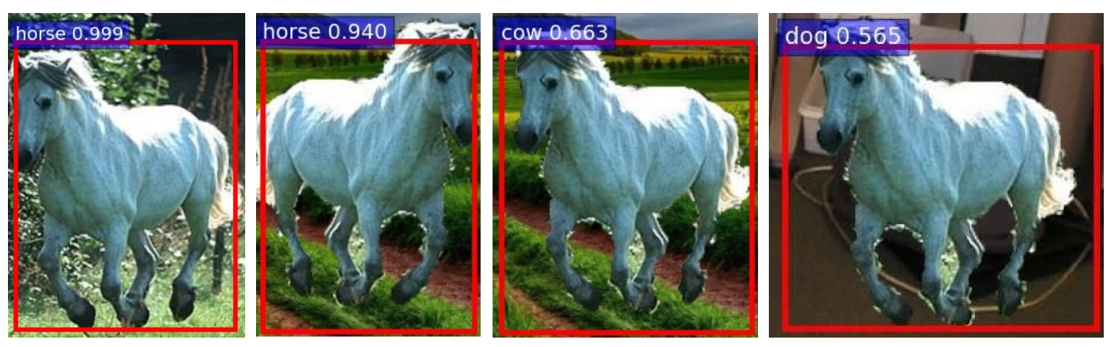
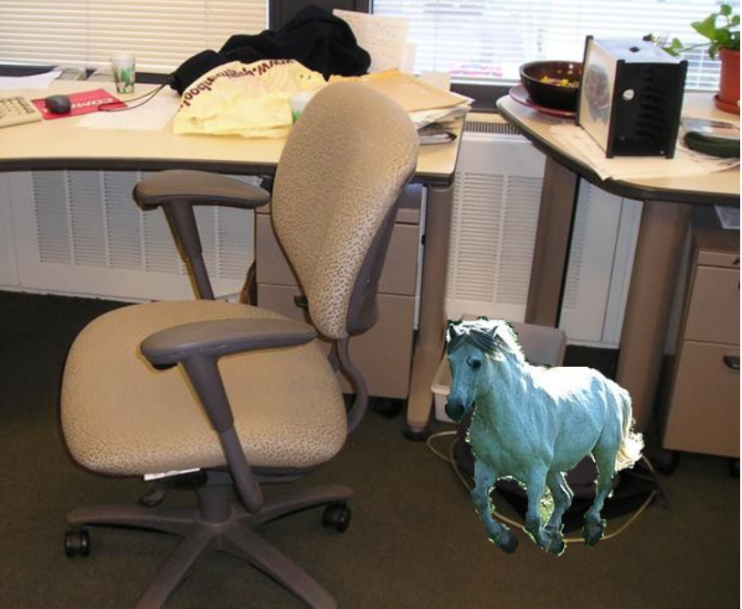
Deep networks can make similarly mistakes to humans:
➔ Environment may change classification.
(a) (b) (c) (d)
BUT: this was a horse...
How do you know?
(a): training example
(b): on road
(c): accross the road…
(d): at the office desk…
There is a need for eXplainable AI (XAI)

Slide 12
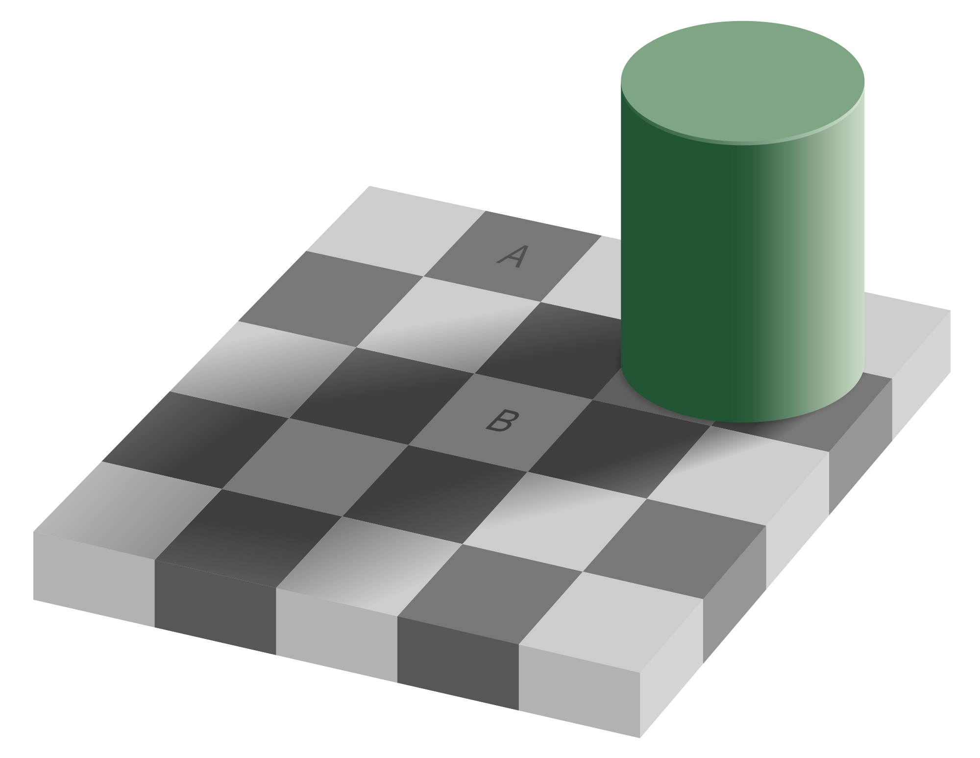
another
„human” error

Slide 13


Slide 14
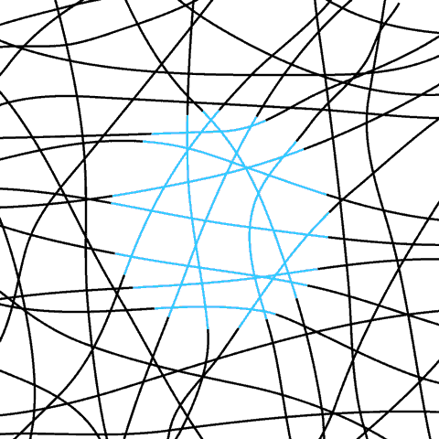

Slide 15
Let us see AI tasks in the real world

Slide 16
Almost the general task

Slide 17
Almost the general task

Slide 18
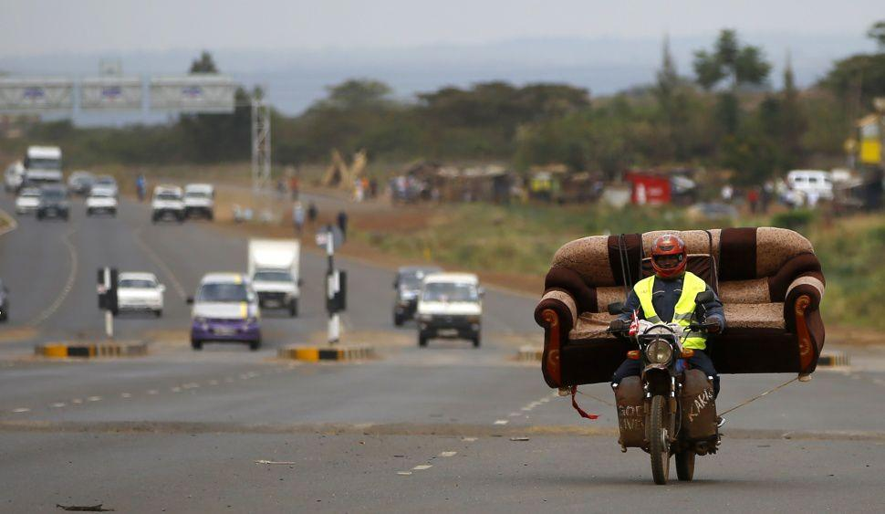
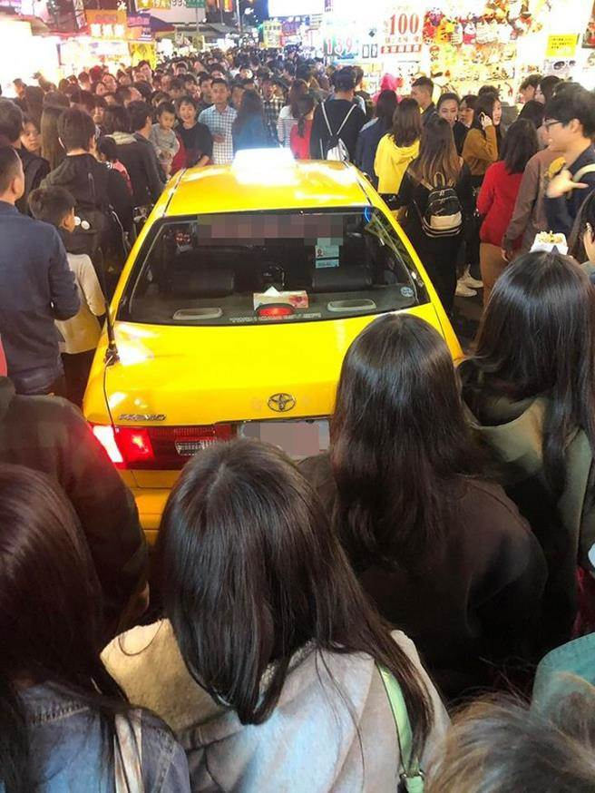
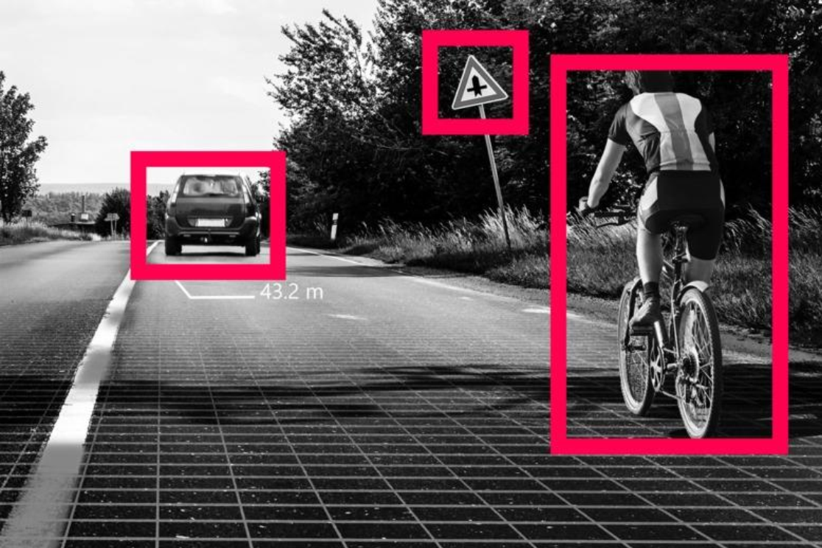
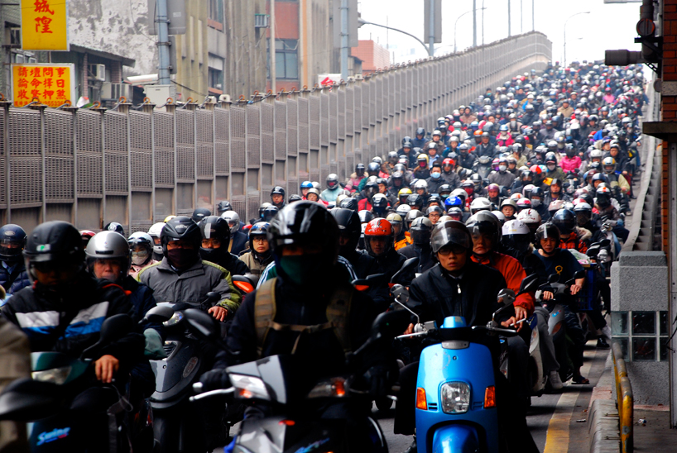
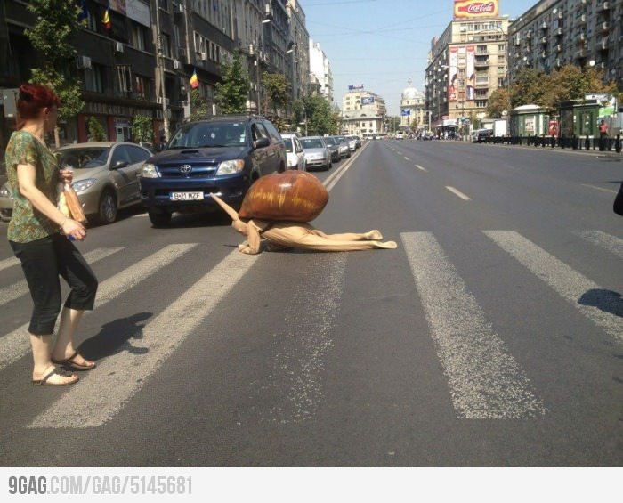
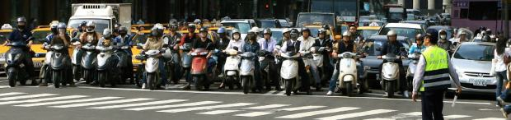
Almost the general task

Slide 19
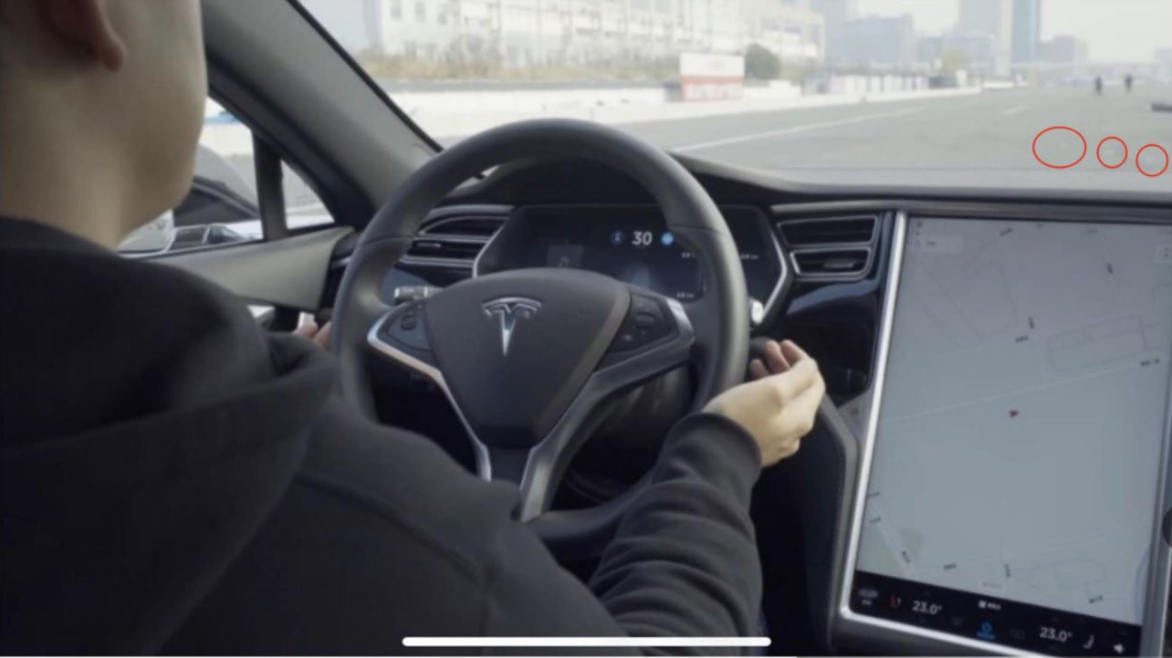
The hard problem of deep learning

Slide 21
In order to understand the problem, let us go back to the example of the horse

Slide 22
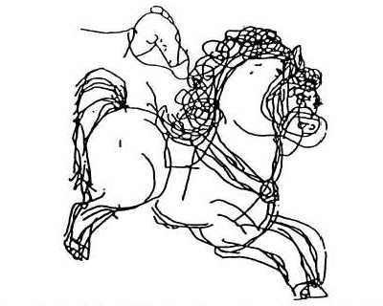
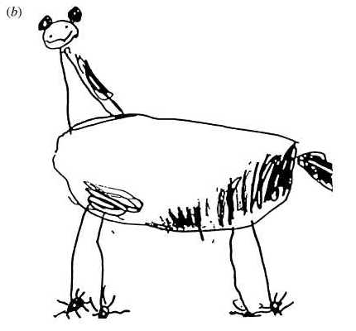
First type of recognition
What is this?
Horse
How do you know?
Second type of recognition
What is this?
Horse?
Why do you think so?
https://www.theguardian.com/artanddesign/2015/dec/09/nadia-chomyn and the references from Lorna Selfe of the author of the link

Slide 23
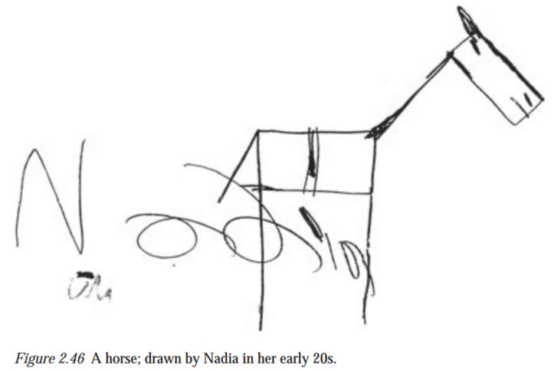
Same autistic person, age: 20 years
She could draw the components of the horse…
First type of recognition
What is this?
Easy to learn (make a photo)
Easy to use (fit two photos)
Does not generalize
Second type of recognition
What is this?
Nothing to learn if we know the components
Easy to communicate
Easy to extend, e.g., for zebra
cf. zero shot learning)
Autistic child, age: 3.5 years
has problems with recognizing parents
“My mother looks so different
from time to time”
4 yr old normal child

Slide 24
Think about this horse example
What are the key features of the components?
Is color a component?
YES, of course!
What is the difference between the two types of components, i.e.,
the components of the horse and
the color/texture of the horse?

Slide 25
The changing world The environment of AI

Slide 26
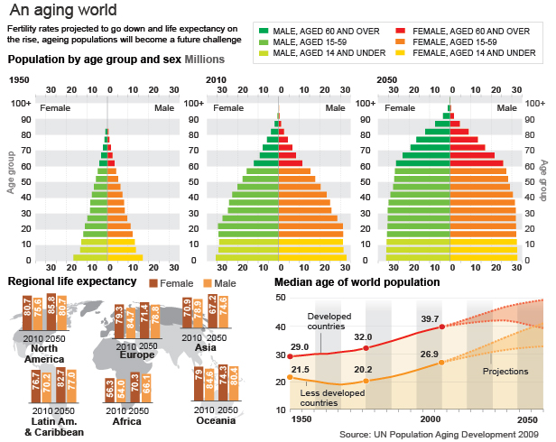
The world is changing very quickly. It is (not only) due to AI

Slide 27
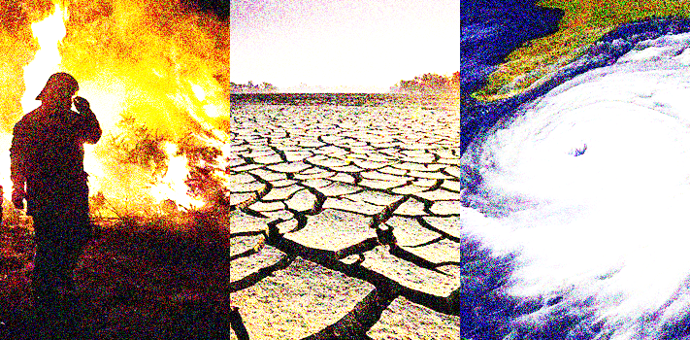
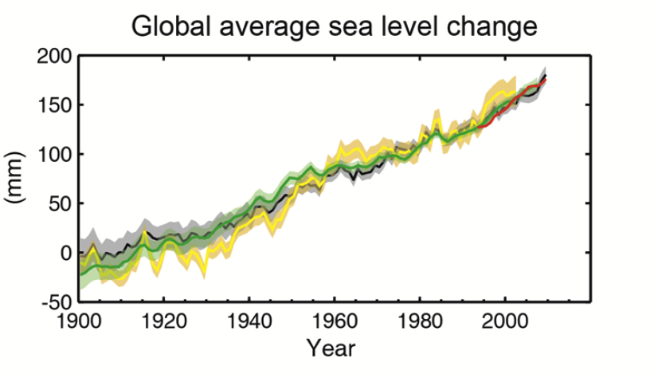
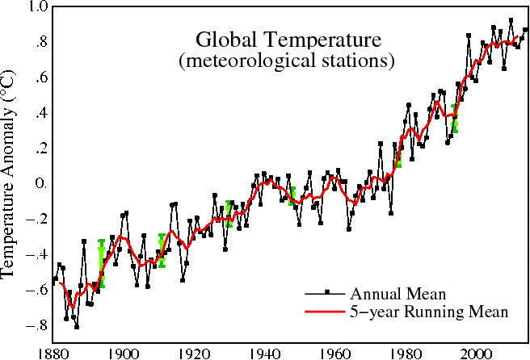
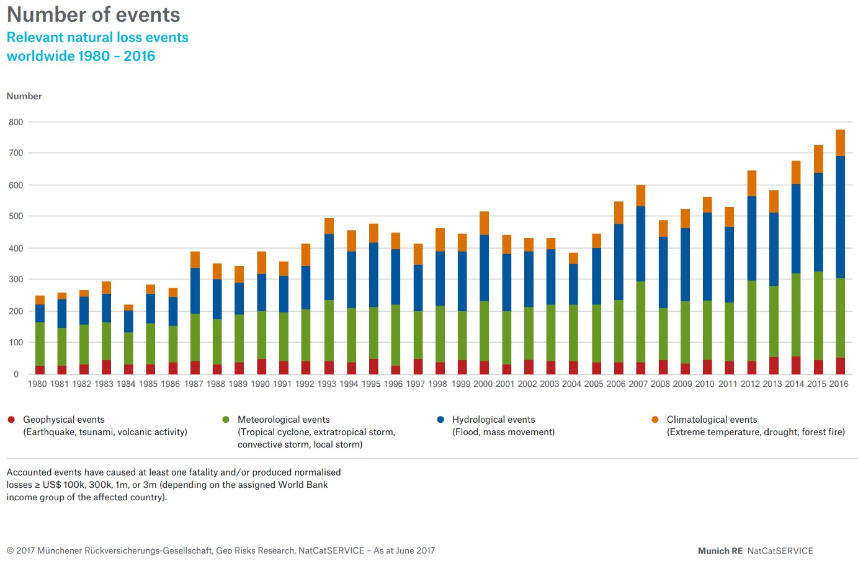
The world is changing very quickly. It is (not only) due to AI

Slide 28
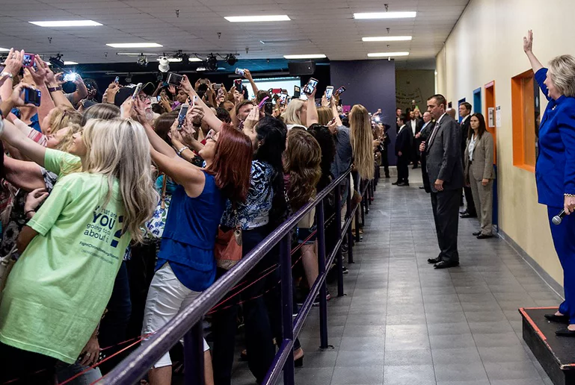
The world is changing very quickly. It is (not only) due to AI

Slide 29
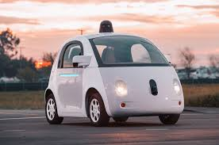
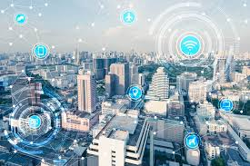
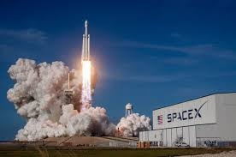
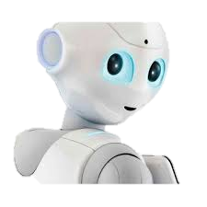
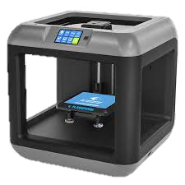
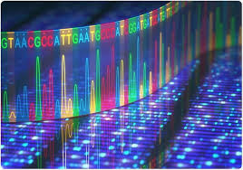
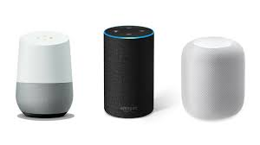
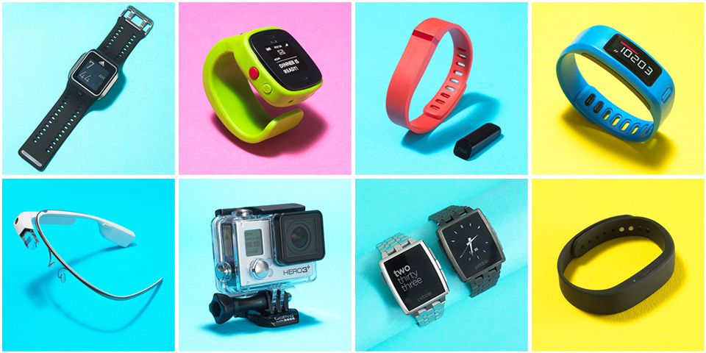

This is due to informatics and AI

Slide 30
A world of social media
This is due to informatics and AI

Slide 31
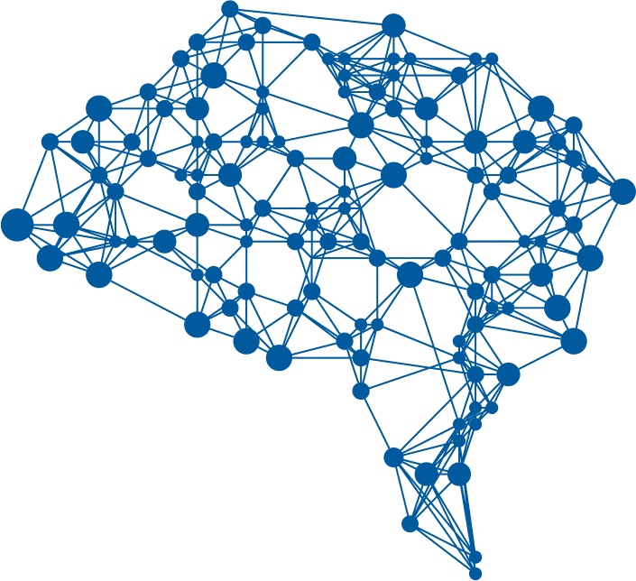




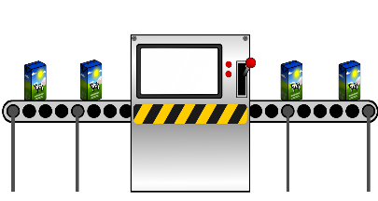
We live in the 4th Industrial Revolution
This is due to informatics and AI
Fourth Industrial Revolution XXI
Third Industrial Rev. mid-end XX
Second Information Revolution
Second Industrial Rev. XIX-XX
First
Inform. Rev.
First Industrial
Revolution XVIII
Artificial Intelligence, information technologies (Big Data, IoT, cloud), nanotechnology, biotech, quantum computing…
Knowledge based on computers and Internet
Mass
production using electricity
Steam Engine

Slide 32
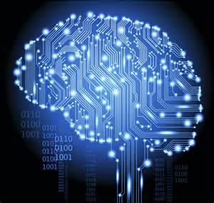
Exponential growth in available data, computing power & storage and complex learning models have enabled significant developments in
data-driven AI
This is due to informatics and AI

Slide 33
EU „Flagships”
AI is part of the national and supra-national strategies
China invests heavily: the State Council of People’s Republic of China has declared to become a $150 billion AI global leader by 2030
USA: $10 billion venture capital channeling in direction of AI in 2019
Russia: According to Russian President Vladimir Putin, the AI leader will rule the world. The country invests $12.5 million annually on AI.
EU launches „Flagships” to catalyze larger EU projects
HumanE-AI – Human-Centered AI – HCAI

Slide 34


Five Key Dimensions
People Society Education
Economy Productivity Labor
Market
Legal and Regulatory Framework
Technology
Ethics

Slide 35

Is this course for you?
Are you interested in AI?
Can you do the weekly homeworks
Would you like to know what to expect from AI?
I don’t know, but would like to be between the first ones who learn it...
If you want to do more than you see on the video
because there are useful applications

Slide 36
Useful applications from us

Slide 37
This
is the
END!
BUT go further
for homeworks and
for the questions!
lorincz@inf.elte.hu

Slide 38
Mathematical Tour on Linear Algebra and related homeworks and Questions about „what we have learned” TASKS for the 1st week

Slide 39
Submit your answers according to the instructions in section „assignments” in CANVAS

Slide 40
Homework
Deadline: before the next talk – as usual.
Limit is milder on Canvas, but points are subtracted according to the late policy.
If the homeworks are hard for you and/or take too much of your time, then drop the course! You need to study more before entering the course.
In case if you need a very basic intro with useful geometric interpretations, then listen to this youtube video:
https://www.youtube.com/watch?v=kZwSqZuBMGg
Homework is from a 17 (21 with cover page + table of content etc.) page, mild introductory book. Answer the „Your Task” subsection at the end of each of the 7 Lessons. To do so, click on the link of
Jason Brownlee
https://machinelearningmastery.com/linear_algebra_for_machine_learning/
Submit your answers to CANVAS -- Assignments!

Slide 41
More literature for the course for
Introductory books to linear algebra and on probabilty theory – They may be of help to you
https://drive.google.com/file/d/1Oax0glSVJl8tUhv92L6GtXxP1vwwfcuW/view?usp=sharing
https://drive.google.com/file/d/1ur3DG-00orKvdH_kI9ixw__1vSlU70fZ/view?usp=sharing
https://drive.google.com/file/d/1JBKM8XQgpk1IIjmAUj5mwwF21IF0whoF/view?usp=sharing
https://drive.google.com/file/d/14b9PTlseUdy_8xjyLQmi8M0mTM744U7G/view?usp=sharing (in Hungarian)
https://drive.google.com/file/d/1xol_u_AyRapyQ4hA3mDCxdmPqlVD0O-y/view?usp=sharing (in Hungarian)
https://drive.google.com/file/d/1Cpci_22k0d3VRYVfUSzY9vlvXfCy_9NI/view?usp=sharing (in Hungarian)
Very good – but hard – books for AI an around AI – for those who want to dig deeper
https://drive.google.com/file/d/11CVxmPXHApPL7zP7IsiraK9iNqDgH-ww/view?usp=sharing
https://drive.google.com/file/d/1gUUHphH9EvOqo5jwff27Mm8LFp4fxchB/view?usp=sharing
Software related
https://drive.google.com/file/d/1bGwper1wzF7scFh9gwFgTlHfiNhWF5PB/view?usp=sharing

